Slide 1
Talend Job Design - Performance Optimization Tips
February 15, 2018
Presenter:

Slide 2
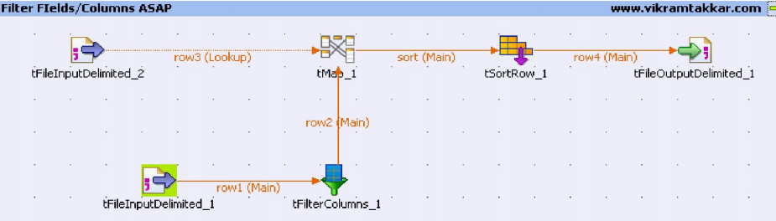
Remove Unnecessary fields/columns as early in design using tFilterColumns component.

Slide 3
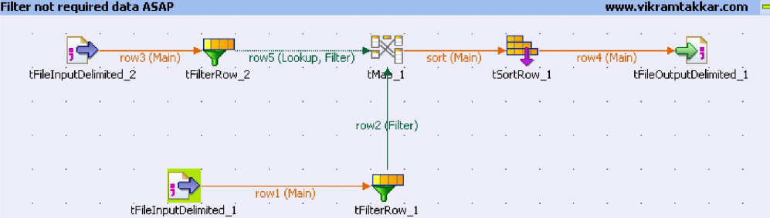
Remove Unnecessary data/records as early in design using tFilterRows component.

Slide 4
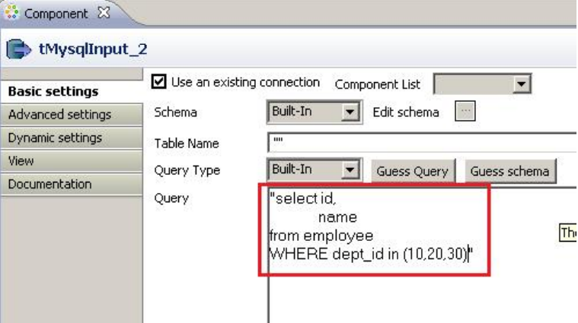
Use Select Query to retrieve data from database

Slide 5
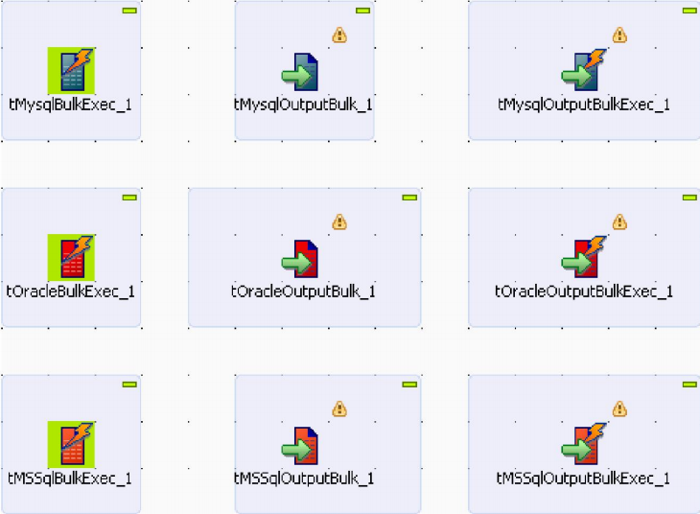
Use Database Bulk components

Slide 6
Use Store on Disk Option
There can be several possible reasons for a low performance of Job. Most common reason may include:
Running a Job which contains a number of buffer components such as tSortRow,
tFilterRow, tMap, tAggregateRow, tHashOutput
Running a Job which processes a very large amount of data.
In Jobs that contain buffer components such as tSortRow as well as tMap, you can
change the basic configuration to store temporary data on disk rather than in
memory. For example, tMap, select the option Store on disk for lookup data to be
stored on a defined path. This will allow not to take the whole data into memory
which will keep the memory available for operations and temp data will be fetched
from disk.

Slide 7
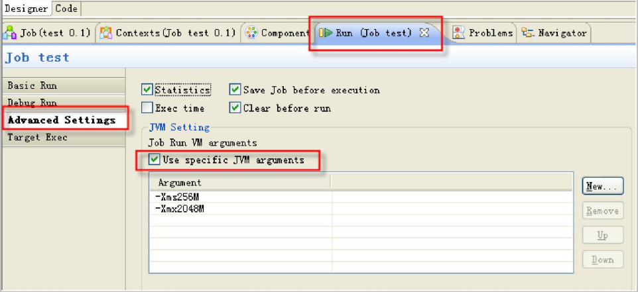
Allocating more memory to the Jobs
-Xms signifies the initial heap size of the Job.
-Xmx signified the maximum size to which heap can grow. (maximum memory
allocated to Job)

Slide 8
Enable Paralleilsm – if possible
Most of the time we need to run few jobs/sub jobs in parallel to maximize the performance and reduce overall job execution time. However, Talend doesn’t automatically execute the sub jobs in Parallel.
You can achieve the parallelization in following two ways:
Using the tParallelize component of Talend. (only available in Talend Integration Suite)
Running SubJobs in Parallel by using the Multithreaded Executions. This option is also
available in Talend Open Studio. However, this option is disabled by default. You can
enable this option from Job view

Slide 9
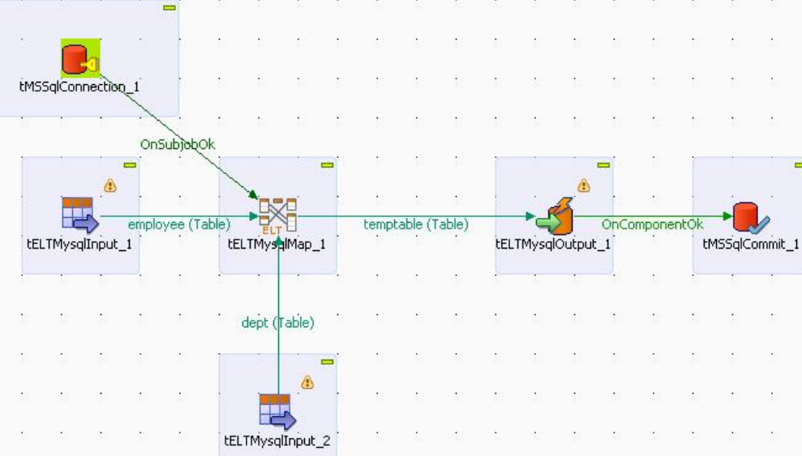
Use Talend ELT Components when required

Slide 10
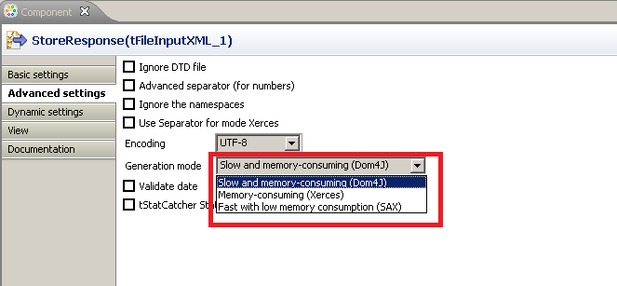
Use SAX parser over Dom4J whenever required
When parsing Huge XML files try using the SAX parser in the Generation mode in the Advanced Settings of tFileInputXML component. However SAX parser comes with few downsides e.g. we can only use basic XPATH expression and can not use expressions like Last , array selection of data [ ] etc. But if your requirement is getting accomplished using SAX parser, you must prefer it over Dom4J.

Slide 11
Use SAX parser over Dom4J whenever required
Slow & Memory Consuming (Dom4J) Parser:
1. Dom4J parser loads the entire XML file into memory before parsing.
2. It uses Object based Model for parsing XML.
3. High memory usage - as it loads the file to memory.
4. We can insert or delete nodes.
5. Traverse in any direction.
6. With Dom4J we can use all the XPATH expressions.
Fast with low Memory Consumption (SAX)Parser.
1. SAX parser parses the XML file Node by Node.
2. It uses Event based Model for parsing XML.
3. Low memory usage as it does not loads the entire file to memory instead read it node by node.
4. We cant insert or delete a node.
5. Top to bottom traversing.
6. With SAX parser we can only use basic XPATH expressions and can not use expressions like last etc.

Slide 12
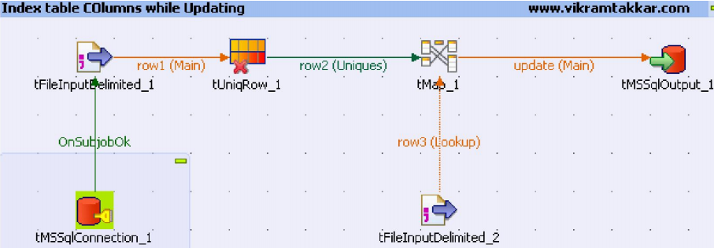
Index Database Table columns when Updating
When updating the data in a table through Talend Job, it is recommended to index the database table columns on the same fields which is defined as Key in the Talend Database output component. Having the index defined on the key will allow the job to run much faster as compared to non indexed keys.

Slide 13
Split Talend Job to smaller Sub jobs
Whenever possible, one should split the complex Talend job to smaller Sub jobs. Talend operates pipe line parallelism i.e. after processing few records it passes to downstream components even if the previous component has not finished processing all records. Hence if we will design a Job having complex number of operations in single sub job then the performance of the job will reduce. It is advisable to break the complex Talend job to smaller Sub jobs and then control the flow of Job using Triggers in Talend.

Slide 14
Questions?
Copyright © 2014 by Vikram Takkar. All Rights Reserved..

